Slide 1
Payment Setup
Mr. Lê Ngọc Hiếu

Slide 2
Payment Methods
Setup PayPal Payment
setup Check/Money Order payment method
set up Bank Transfer payment method
set up Cash on Delivery (COD) payment method
set up Zero Subtotal Checkout payment method
set up Purchase Order (PO) payment method
set up Authorize.net method

Slide 3
Payment Methods
Payment Methods in Magento 2
Magento 2 supports the following payment methods:
1. Check/Money Order
2. Bank Transfer Payment
3. Cash on Delivery Payment
4. Zero Subtotal Checkout
5. Purchase Order
Out of the box, Magento 2 also supports third-party services PayPal and Authorize.net for payment. To activate these methods, we just need to enter our personal data received from the payment provider.

Slide 4
1. Check/Money Order
In this method, the store owner accepts the payment for an order from the customer through the check or money order. We can set up the Check/Money Order as a default payment method, which we can apply for our online store in Magneto 2. We have the right to set that the Check/Money Order accepts either from some countries that we have chosen or from all countries. We can also set the range of order value.
2. Bank Transfer Payment
With the bank transfer payment method, the store owner accepts the payment from a customer's bank account to the merchant bank account. The customer buys the products online and pays to the store owner through the bank transaction. They transfer the money from their account, which is deposited into the merchant (store owner) account

Slide 5
3. Cash on Delivery Payment
Cash on delivery generally called COD. It is an oldest way of payment. By setting this method, the store owner accepts the money from the customer in cash for their purchase. The customer buys the product and pays to the delivery guy, and he brings the money back to the store owner.
Similar to the Check/Money Order option, we (store owner) can set our store to accept the COD payment from some countries which we have chosen as well as the maximum order value that will be accepted.

Slide 6
4. Zero Subtotal Checkout
Zero Subtotal Checkout is a payment method that is available only for orders created from the admin. It can be used for orders with a subtotal of zero that is taxed after a discount is applied. The Zero Subtotal checkout method is used when the subtotal of the order is zero means that the customer doesn't need to pay anything for purchase.
For Example - The Zero Subtotal might be used in the following situations:
1. The discount covers the full price of the purchase, with no extra charges for shipping.
2. The price of the simple product is zero, and the Free Shipping is available.
3. The customer adds a virtual or downloadable product to the shopping cart, and the price equal to zero.
4. The coupon code covers the full price of the products and shipping.

Slide 7
5. Purchase Order (PO)
A purchase order (PO) allows the commercial customers to pay for authorized purchases by referencing the PO number. The purchase order (PO) is authorized and issued in advance by the company, which is making the purchase.
The customer needs to select the Purchase Order as the method of payment during checkout. On receiving the invoice receipt, the company processes the payment in their payable system, and pay for the purchase.

Slide 8
6. PayPal
Paypal is divided into three categories in Magento. Each of them has sub-methods that should be configured individually. In general, you must be a PayPal user to equip your store with these payment methods.
As a store owner, you can apply PayPal Payment (Standard, Pro, or Advanced) and Express Checkout to accept credit card payment.
PayPal Payment Standard is an easiest way to accept the online payments, we just add a checkout button to our website. It's completely free of cost and allows us to accept credit card and PayPal. The only drawback of PayPal Payment Standard is - it does not allow your customers to complete the checkout process on your site. So, to complete their payment, customers will be redirected to PayPal.
PayPal Express Checkout is a bit complicated, as it needs either a premier or business account. The customer just taps the "Check with PayPal" button and complete the payment with 3 steps.

Slide 9
7. Authorize.net
It is one of the most popular onsite payment gateways, which is included in Magento 2 by default. It allows the customer to complete the checkout process without leaving a website. All the information of a customer is transmitted through a security gateway.
This feature saves the time of the customer and makes the payment process easier.
8. Braintree
Braintree is a PayPal company which provides a wide range of payment methods in one service. By activating this, the store owners are able to receive payments via different credit and debit cards and PayPal.

Slide 10
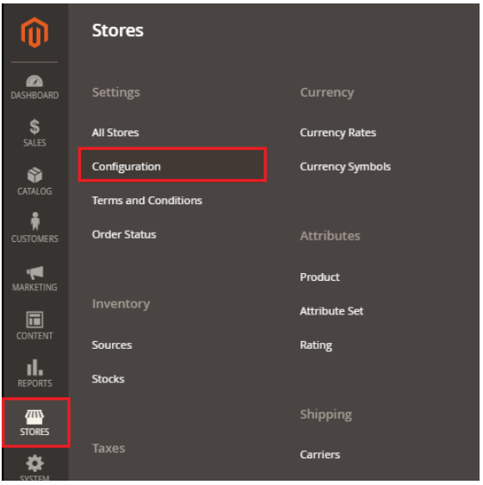
Setup PayPal Payment
PayPal Setup in Magento 2
Step 1: Login to the Magento 2 Admin Panel.
Step 2: On the left sidebar of Magento 2, Navigate to SYSTEM >> Configuration.

Slide 11
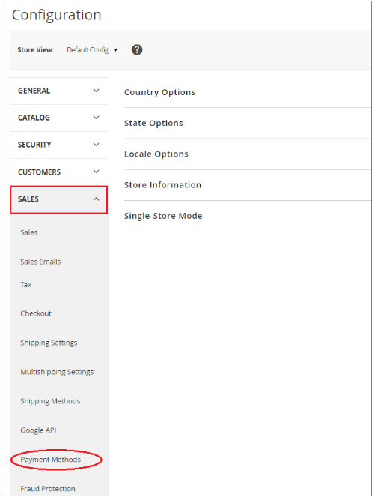
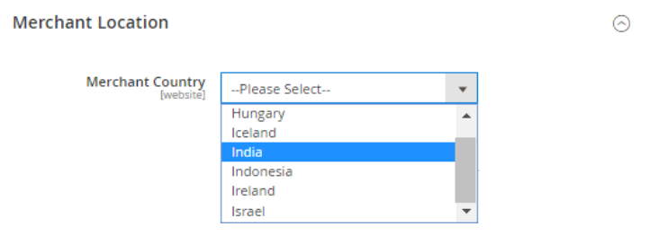
Step 3: Here, you will get the list of options on the left side of the page. Scroll down and go to the Sales tab and click on the Payment Methods option.
Step 4: Under the Merchant Location section, choose the merchant country from the dropdown list where your business is located or your business is registered from which country.
If you do not select the country here, then by default country from the General Config will be used.

Slide 12
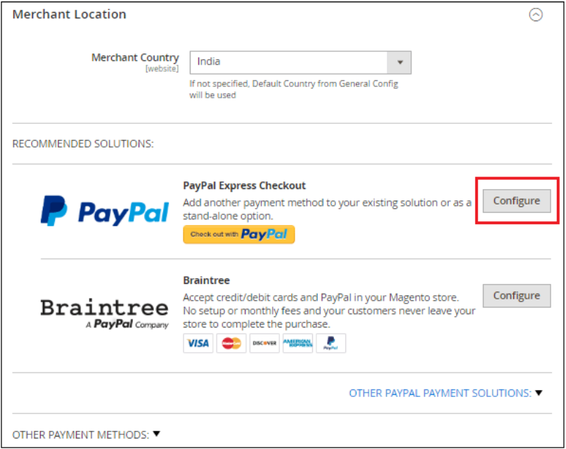
Step 5: Magento 2 provides the following payment methods, which add PayPal as an additional payment method to the checkout page. Click on the Configure button corresponding to the PayPal Express Checkout to make PayPal settings.

Slide 13
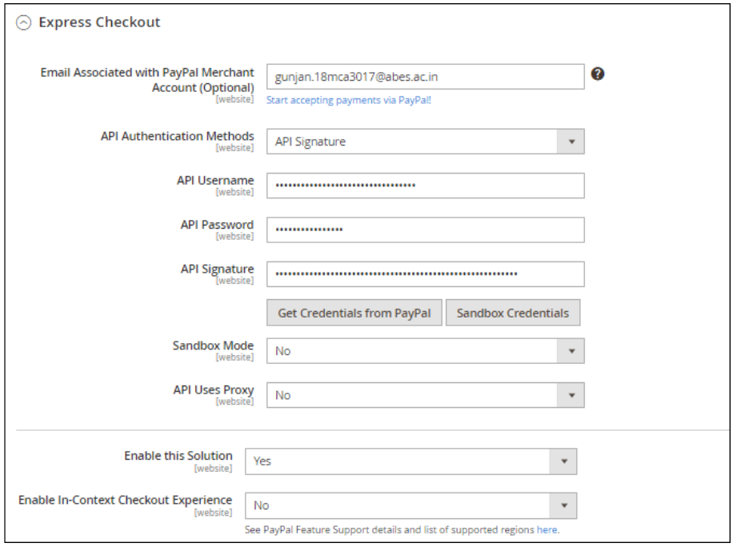
Step 6: Provide the required details to complete the PayPal setting:

Slide 14
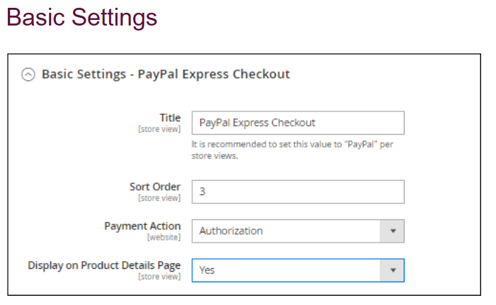
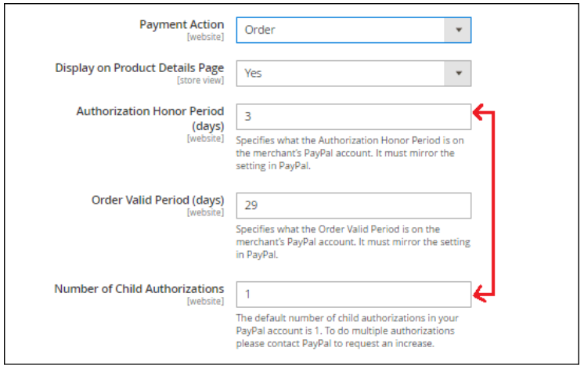
Step 7: After completing the above information, we need to set up the Basic and Advanced setting of the PayPal payment method, as given below.
If you choose Order for the Payment Action field, it will display three more fields to complete. You must enter the number of days that primary authorization/order is valid, order valid period, and the maximum number of authorization for a single order.

Slide 15
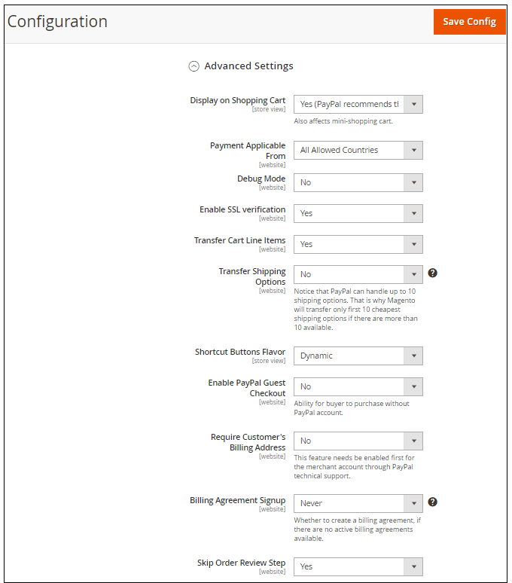
Advanced Settings
Complete the advanced settings by providing the required information in the fields.

Slide 16
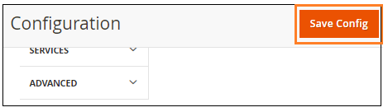
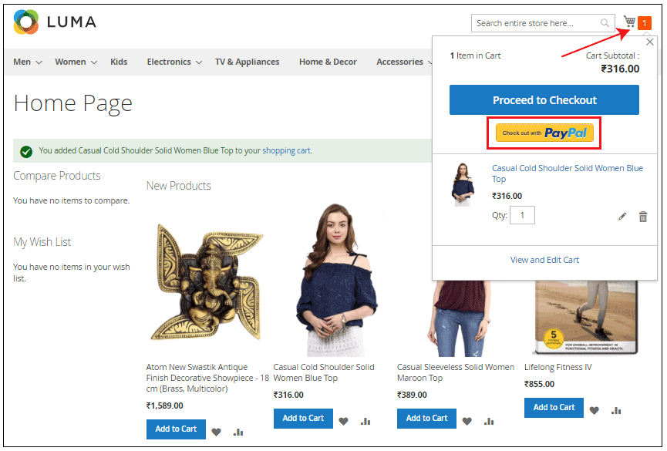
Step 8: Click on the Save Config button to save the changes.
Step 9: Once we configured the PayPal Express Checkout payment method, it will show up on the frontend with the criteria we have set from the backend. Now, customers can choose the PayPal payment method and place orders successfully.

Slide 17
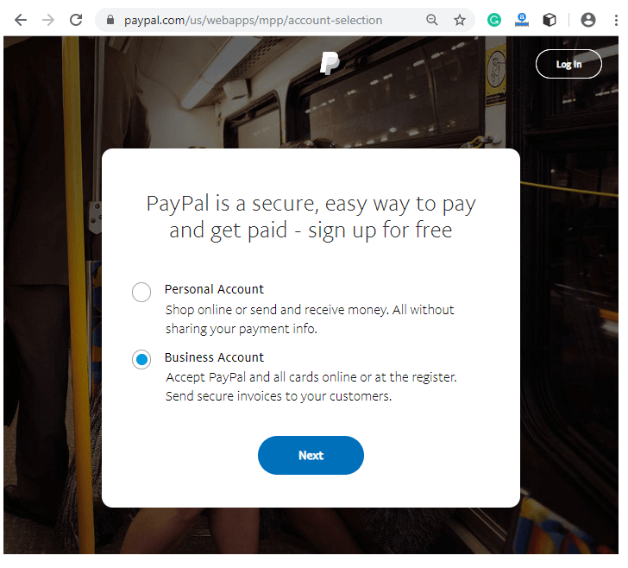
Create a PayPal Account and get API Credentials
Step 1: Go to PayPal site www.paypal.com and Sign up. Create an account, which you want to create by providing the required information. It may be either a Personal Account or Business Account.
You can get the API Username, API Password, and API Signature from here after creating an account.

Slide 18
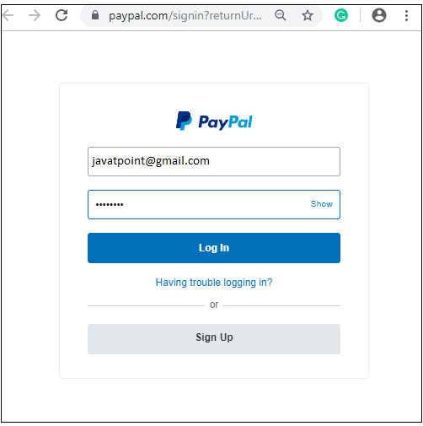
Step 2: Now, login to the PayPal account with your registered id and password to get API Credential using the following link GET CREDENTIAL. It will directly redirect you to the Request API Credential Page.

Slide 19
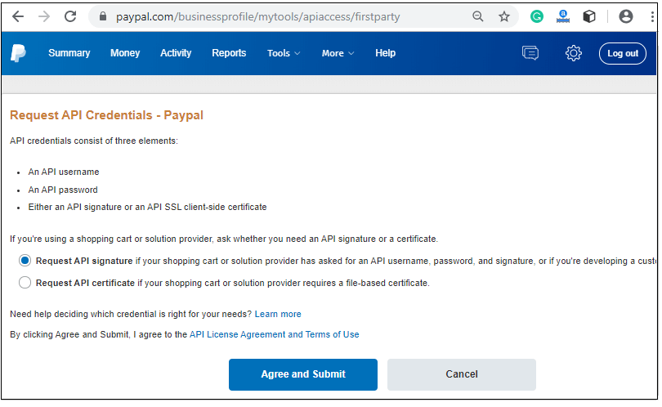
Step 3: You will be redirected to a new window as given below in the screenshot, where you request for the API Credentials. Choose either API Signature or API Certificate and click on the Agree and Submit button. We choose API Signature here.

Slide 20
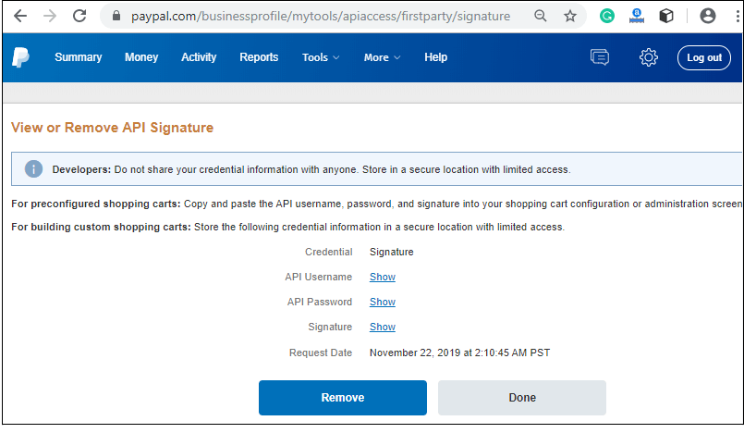
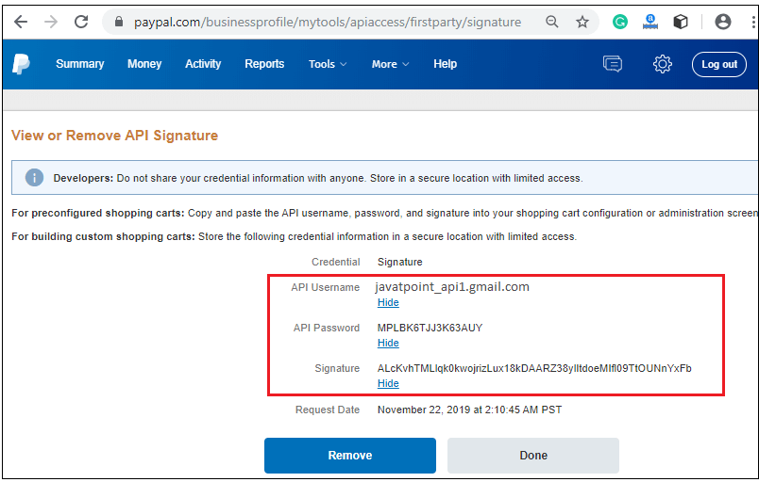
Step 4: It will move to a new screen, where you view and remove API Signature as given in the below screenshot. Click on the Show link corresponding to the API Username, API Password, and Signature.
Step 5: API Username, API Password, and Signature are now visible on the screen to you. Copy and paste them to the PayPal Express Checkout configuration.

Slide 21
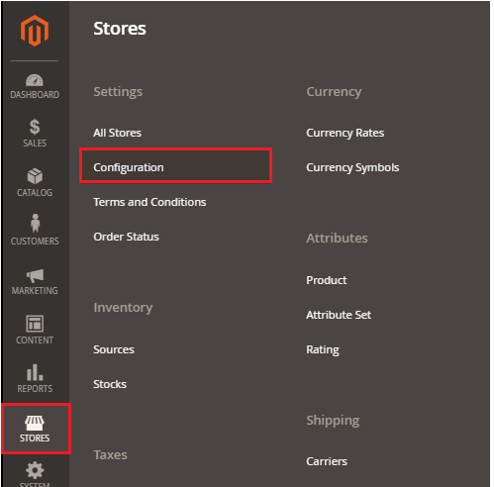
Setup Check/Money Order payment method
How to setup Check/Money Order payment method in Magento 2?
Step 1: Login to the Magento 2 Admin Panel.
Step 2: On the left sidebar of Magento 2, Go to STORE >> Configuration.

Slide 22
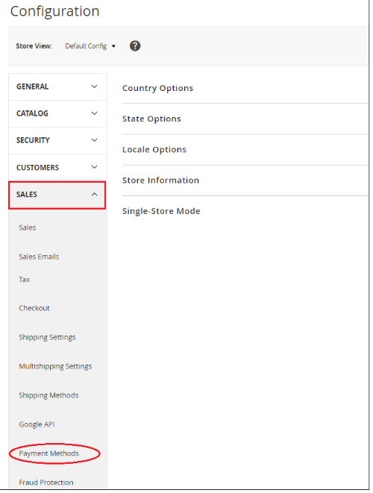
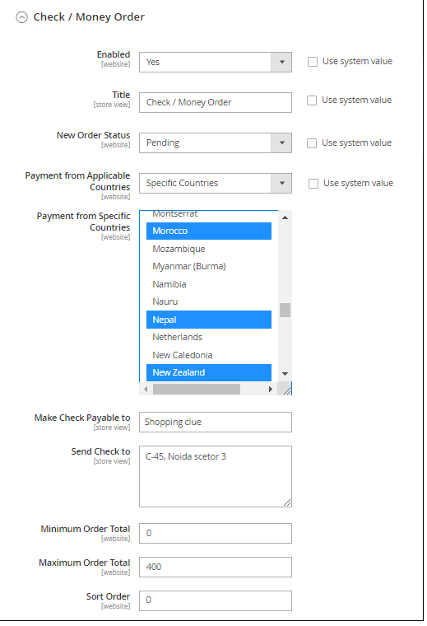
Step 3: Under the Sales section, click on the Payment Method.
Step 4: Here, we need to expand the Check/Money order section and complete the given fields by providing the required details.

Slide 23
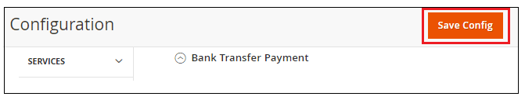
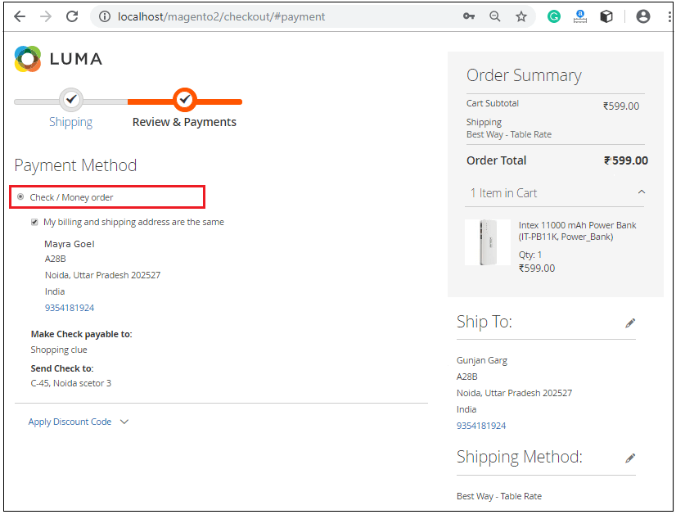
Step 4: After completing all the required details, click on the Save Config button to confirm the Check/Money Order payment Gateway in Magento 2.
Step 6: Once we saved Check/Money Transfer payment method, it will show up in frontend with the criteria we have set from the backend. Customers can select their preferred payment method and place orders successfully.

Slide 24
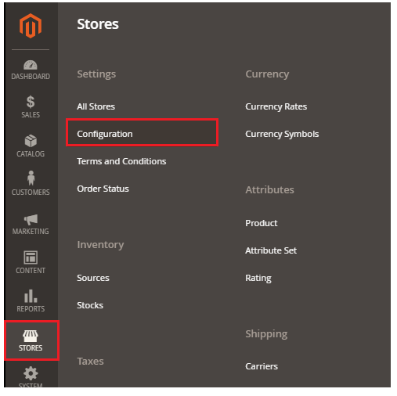
set up Bank Transfer payment method
How to set up Bank Transfer payment method in Magento 2?
Step 1: Login to the Magento 2 Admin Panel.
Step 2: On the left sidebar of Magento 2, Go to STORE >> Configuration.

Slide 25
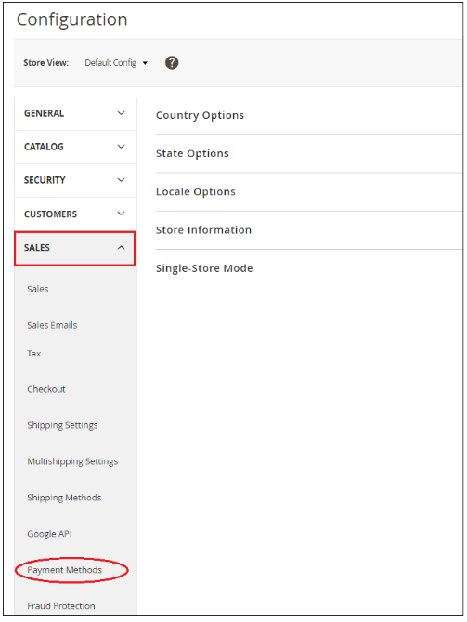
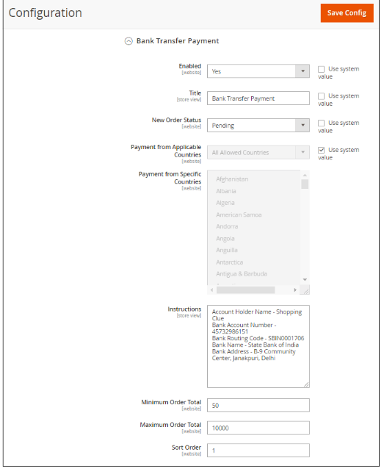
Step 3: Under the Sales section, click on the Payment Method.
Step 4: Now, we need to expand the Bank Transfer section to configure it for our Magento 2 store. Here we will find several fields to configure the payment method.

Slide 26
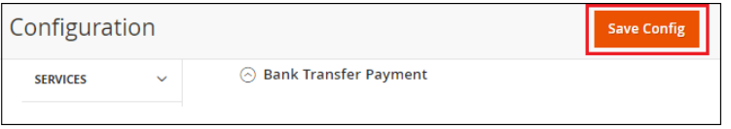
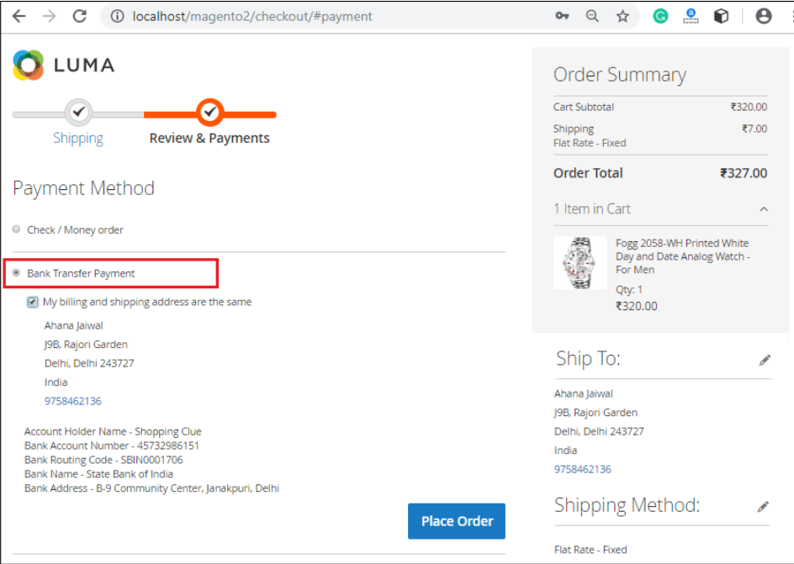
Step 5: Click on the Save Config button to confirm the Bank Transfer payment in Magento 2.
Step 6: Once we saved the bank transfer payment method, it will show up on the frontend with the criteria we have set from the backend. Customers can choose their preferred payment method and place orders successfully.

Slide 27
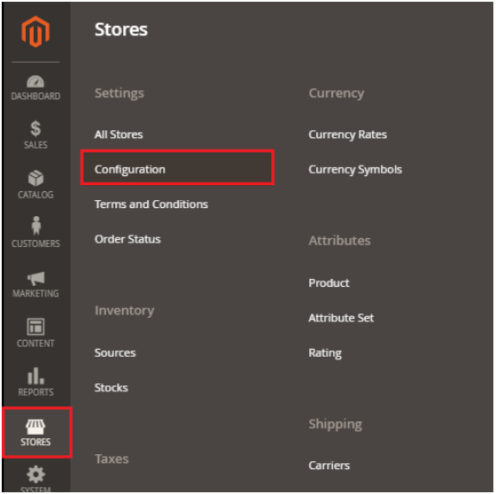
set up Cash on Delivery (COD) payment method
How to set up Cash on Delivery (COD) payment method in Magento 2?
To set up the Cash on Delivery (COD) as a payment method, follow the below steps:
Step 1: Login to the Magento 2 Admin Panel.
Step 2: On the left sidebar of Magento 2, Go to STORE >> Configuration

Slide 28
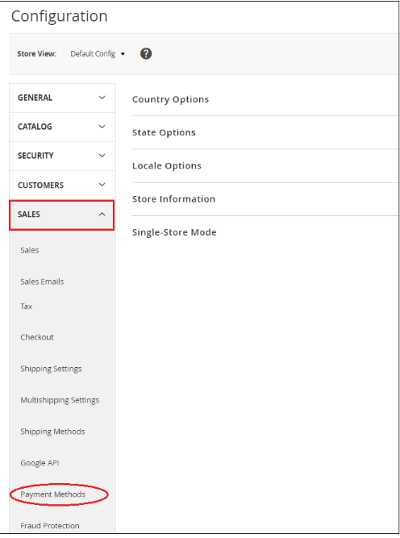
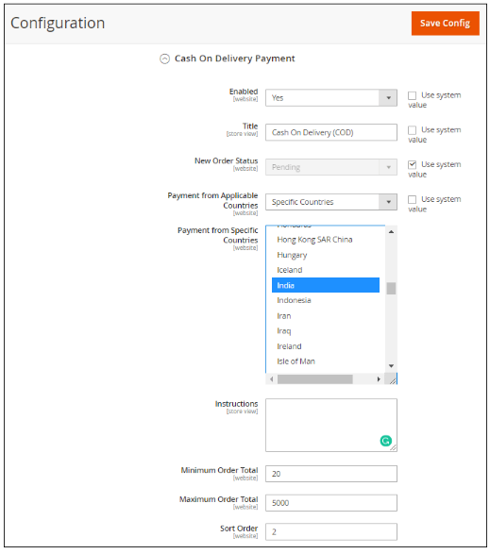
Step 3: Under the Sales section, click on the Payment Method.
Step 4: Expand the Cash on Delivery Payment section to configure it for our Magento 2 store. Here we will find several fields to configure the payment method.

Slide 29
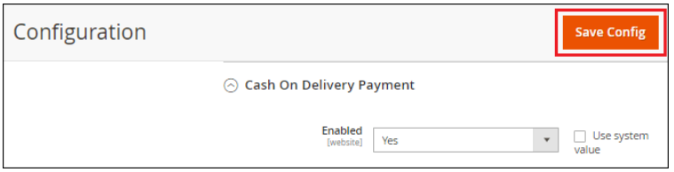
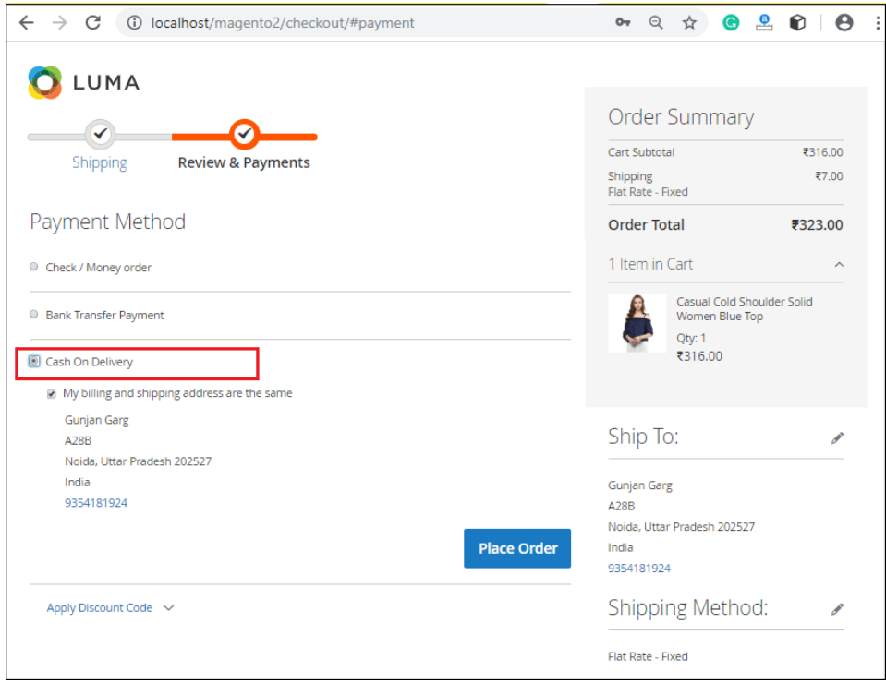
Step 5: Click on the Save Config button to confirm the Cash on Delivery payment in Magento 2.
Step 6: Once we saved Cash On Delivery (COD) payment method, it will show up on the frontend with the criteria we have set from the backend. Customers can select the payment method as per their choice and place orders successfully.

Slide 30
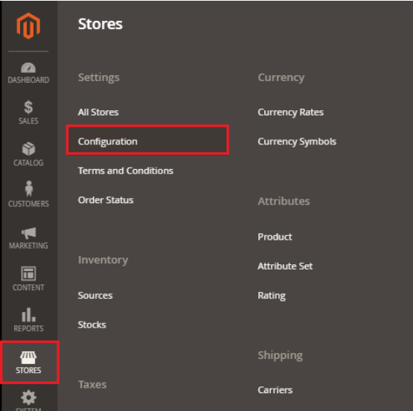
set up Zero Subtotal Checkout payment method
How to set up Zero Subtotal Checkout payment method in Magento 2?
To set up the Zero Subtotal Checkout as a payment method, follow the below steps:
Step 1: Login to the Magento 2 Admin Panel.
Step 2: On the left sidebar of Magento 2,
Go to STORE >> Configuration.

Slide 31

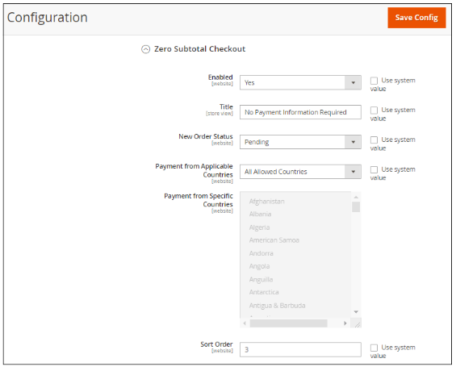
Step 3: Under the Sales section, click on the Payment Method.
Step 4: Here, we need to expand the Zero Subtotal Checkout section and complete the given fields by providing the required details.

Slide 32
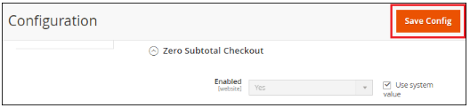
Step 5: When completed, click on the Save Config button to confirm the Zero Subtotal Checkout payment method.
Step 6: Once we saved the Zero Subtotal checkout payment method, it will show up in frontend with the criteria we have set from the backend. Customers can choose their preferred payment method and place orders successfully.

Slide 33
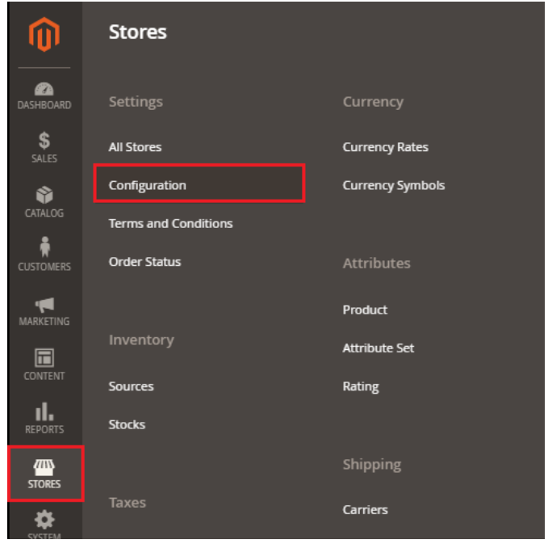
set up Purchase Order (PO) payment method
How to set up Purchase Order (PO) payment method in Magento 2?
To set up the Purchase Order (PO) as a payment method, follow the below steps:
Step 1: Login to the Magento 2 Admin Panel.
Step 2: On the left sidebar of Magento 2, Go to STORE >> Configuration.

Slide 34

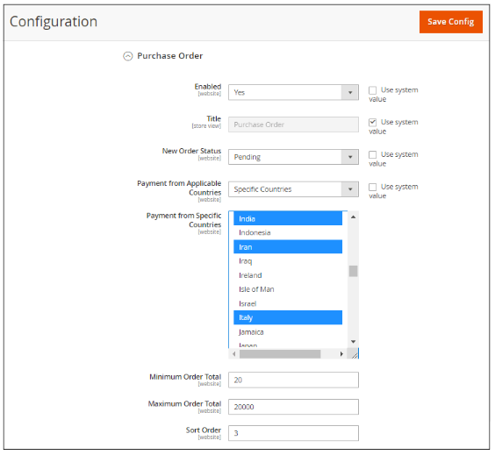
Step 3: Under the Sales section, click on the Payment Method.
Step 4: Here, we need to expand the Purchase Order section and provide the required details to set up the Authorize.net payment method.

Slide 35
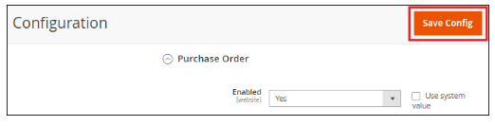
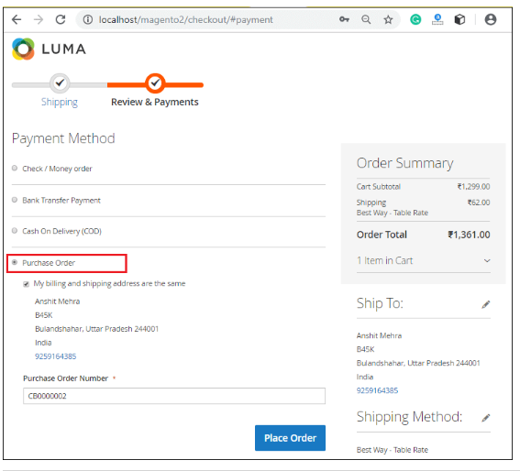
Step 5: When completed, click on the Save Config button to confirm the Purchase Order (PO) payment method.
Step 6: Once we saved the Purchase Order (PO) payment method, it will show up in frontend with the criteria we have set from the backend. Customers can select their preferred payment method and place orders successfully.

Slide 36
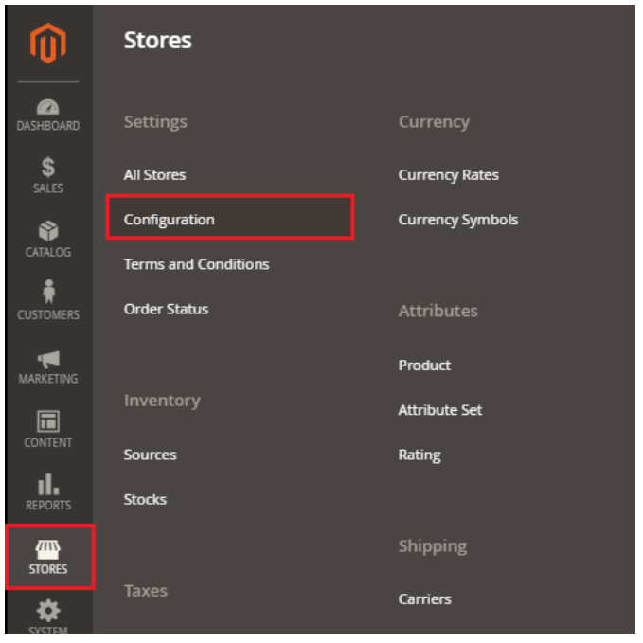
set up Authorize.net method
How to set up Authorize.net method in Magento 2?
To set up the Authorize.net payment method in Magento 2 website, follow the below steps:
Step 1: Login to the Magento 2 Admin Panel.
Step 2: On the left sidebar of Magento 2, Go to STORE >> Configuration.

Slide 37
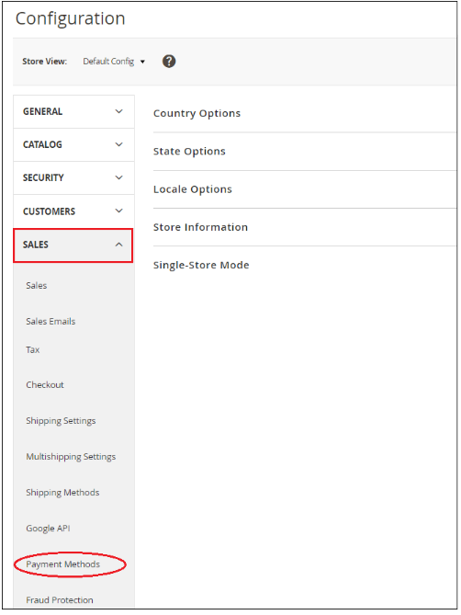
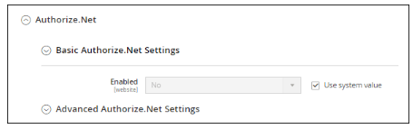
Step 3: Under the Sales section, click on the Payment Method.
Step 4: Expand the Authorize.net section and set up the Basic and Advanced settings of Authorize.net.

Slide 38
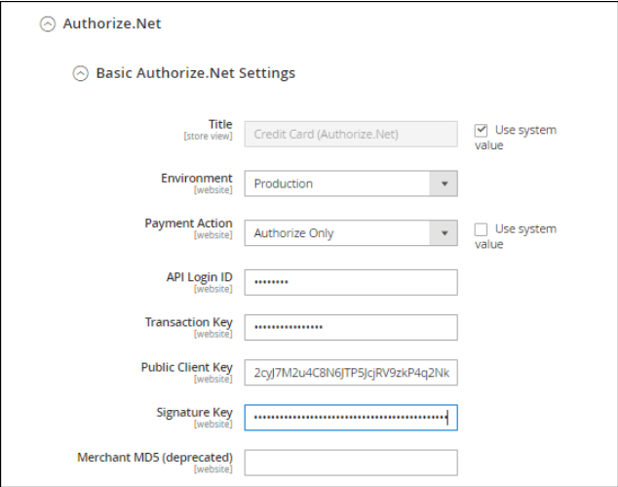
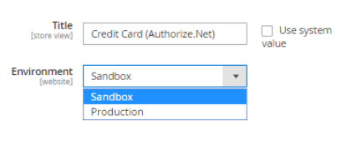
Basic Authorize.net Settings
Explore this section and complete the basic setting by providing the required details in the given fields:
Title: Enter the title of the payment method, which will display on the frontend during customer checkout.
Environment: Choose Production or Sandbox in Environment field.
If the Authorize.net is currently running in test mode, then choose Sandbox. Otherwise,
To set up CardinalCommerce for Authorize.net in a live store, then select Production.
Payment Action: In Payment Action field, choose one of the following options:

Slide 39
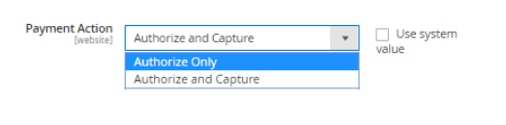
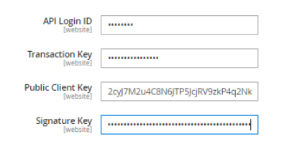
Authorize Only: It authorizes customer's funds and creates an order in our store. Later we can create an invoice and capture the customer's funds.
Authorized and Capture: It authorizes and captures customer funds as well as creates order and invoice in our store.
We need to fill the information API Login ID, Transaction Key, and Signature Key field for our Authorize.net account.
API Login ID: Enter the API login id to this field.
Transaction Key: Provide the transaction key in this field.
Public Client Key: Enter the Public Client Key in this field.
Signature Key: Enter the Signature Key in this field.
To get the API login ID, Transaction Key, and Signature Key follow the below instruction.

Slide 40
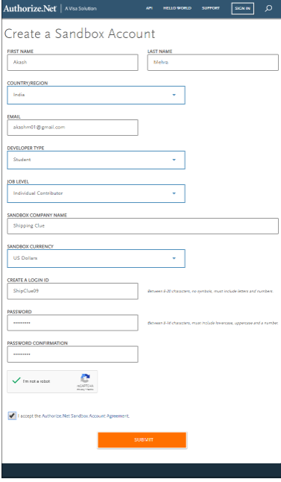
Step 1: Create an account on Authorize.net using the following link https://developer.authorize.net/hello_world/sandbox/. Fill the information and click on the submit button after accepting the Authorize.net Sandbox Account Agreement by marking on the checkbox.

Slide 41
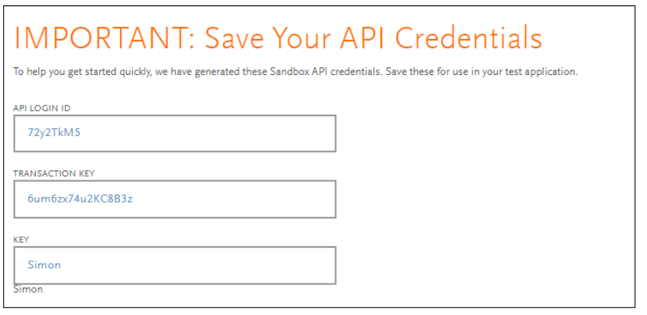
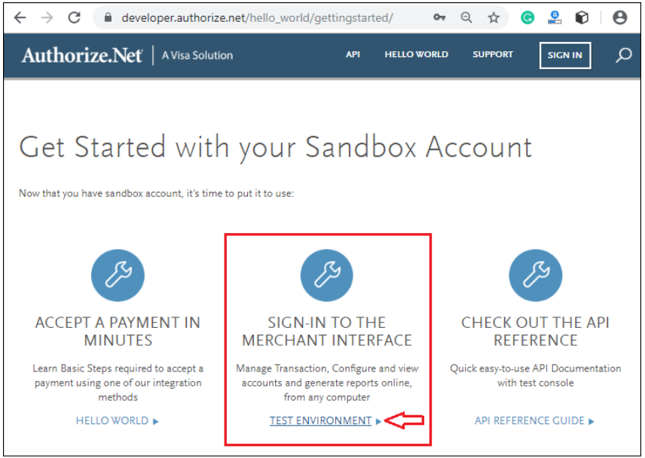
Step 2: It will redirect to the new window where you will get the API Login ID and Transaction Key. Copy them from here and paste in Authorize.net payment gateway in Magento 2.
Step 3: To get the Public Client Key and Signature Key, you need to sign-in to the merchant interface of the Authorize.net account as given in the below screenshot.

Slide 42
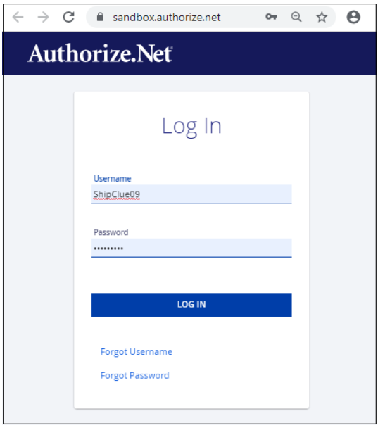
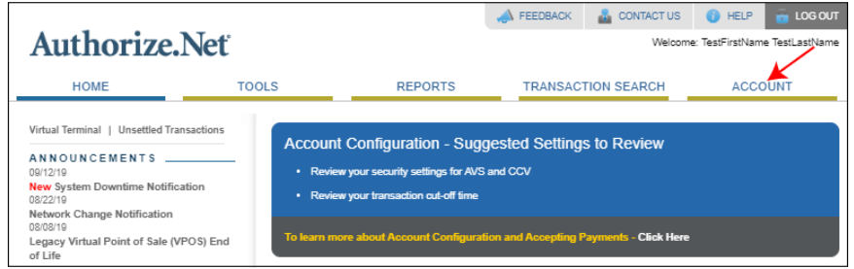
Step 4: Enter the username and password, which you have created while creating an account of Authorize.net.
Step 5: On the Home page of Authorize.net, click on Account from the main toolbar at the upper-right corner.

Slide 43
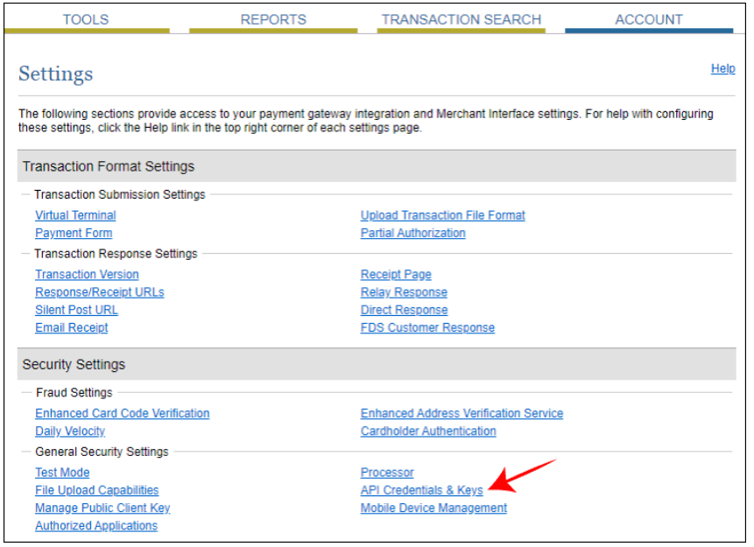
Step 6: To obtain the Signature Key, click on the API Credential and Keys under the General Security Settings.

Slide 44

Step 7: Now, scroll down and click on the New Signature Key radio button. To disable the old Signature Key, click on the Disable Old Signature Key checkbox. If you do not select it, then the old Signature Key will automatically expire in 24 hours. Click on submit to continue.

Slide 45


Step 8: Click on the Request PIN for verification.
Step 9: Enter the verification PIN, which you got on your registered email id from the Authorize.net.

Slide 46


Step 10: Identity is verified successfully. Click on the Continue button, which will redirect you to a new page.
Step 11: Copy the new generated Signature Key and paste it to the Signature Key field in Magento 2 Authorize.net payment set up.

Slide 47

Step 12: To obtain the Public Client Key, click on the Manage Public Client Key under the General Security Settings on the same page.

Slide 48


Step 13: Click on Submit and continue.
Step 14: Request for the PIN and verify it in the same way as you verified the Signature Key.
Step 15: Copy the New Client Key and paste it into the Public Client Key field in Magento 2.

Slide 49


Now, back to the Authorize.net page set up and continue.
Enabled: Enable the Authorize.net payment method by setting Yes so that it will be visible to the customer during checkout.
Advanced Authorize.net Settings
Explore this section and complete the Advanced settings by providing required details in the given fields:
Accepted Currency: Set the accepted currency to the US dollar or any other currency that is acceptable at your online store.
Debug: To save the logs between Authorize.net system and your store set Yes to debug field.
Email Customer: Set Yes to this field, if you want to send an email to the customers and type your business email address in the Merchant's Email field.
Enable Credit Card Verification Field: Enable this field by setting Yes that requires a credit card verification code (CVV).
Credit Card Types: Select the cards from the list of Credit Card Types that is accepted by your store with the Ctrl key.

Slide 50


Step 5: When completed basic and advanced settings, click on the Save Config button to configure the Authorize.net payment method.
Step 6: Once we saved the Authorized.net payment method, it will show up on the frontend with the criteria we have set from the backend. Customers can select their preferred payment method and place orders successfully.
Here the customers need to provide the credit card details like credit card number, expiry date, and CVV number to place an order.

